Slide 1
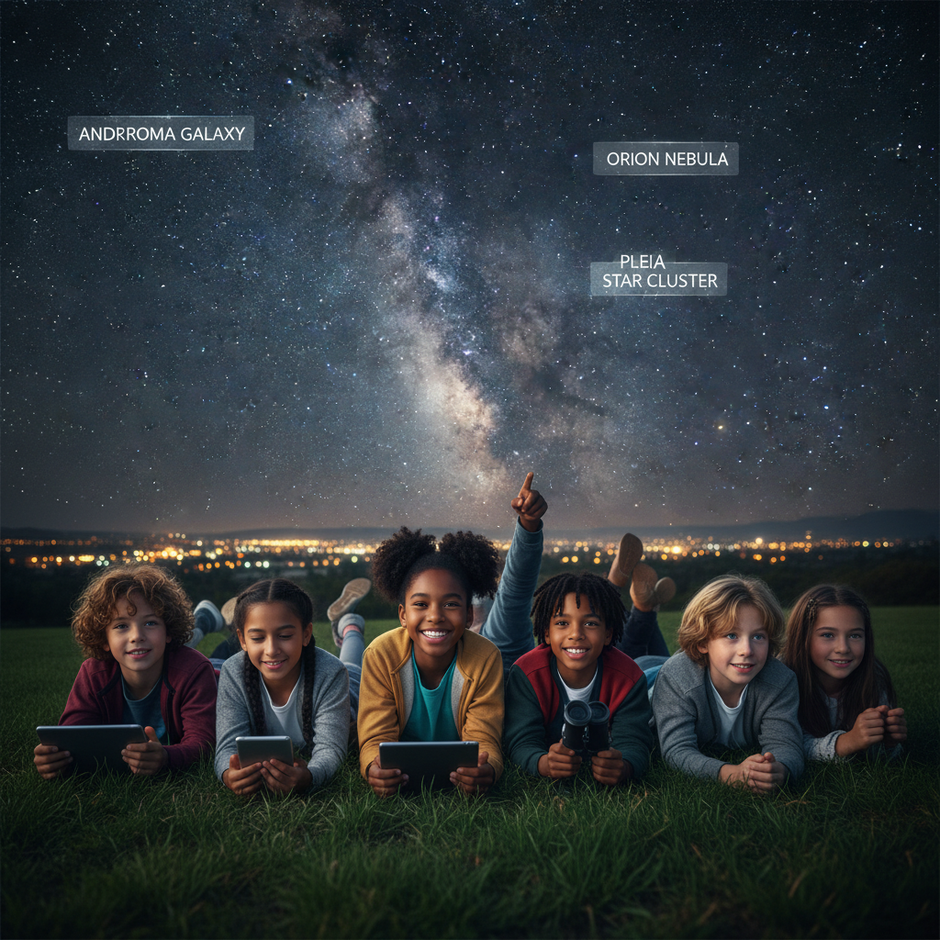
ModelIt!
Student Lesson
The Light You're Seeing Is Already Old
When You Look at a Star, You're Seeing the Past
NGSS: 5-ESS1-1
5th Grade
1/9

Slide 2
What You Will Learn Today
Learning Goals
* Explain that apparent brightness depends on both distance and actual luminosity
* Model how distance affects both light travel time and apparent brightness
* Predict how apparent brightness changes with distance
* Articulate that observing stars means observing the past
Key Vocabulary
Light Year
The distance light travels in one year (~6 trillion miles)
Luminosity
The actual amount of energy a star produces
Apparent Brightness
How bright a star appears when viewed from Earth
Inverse Square Law
Brightness decreases by the square of the distance
2/9

Slide 3
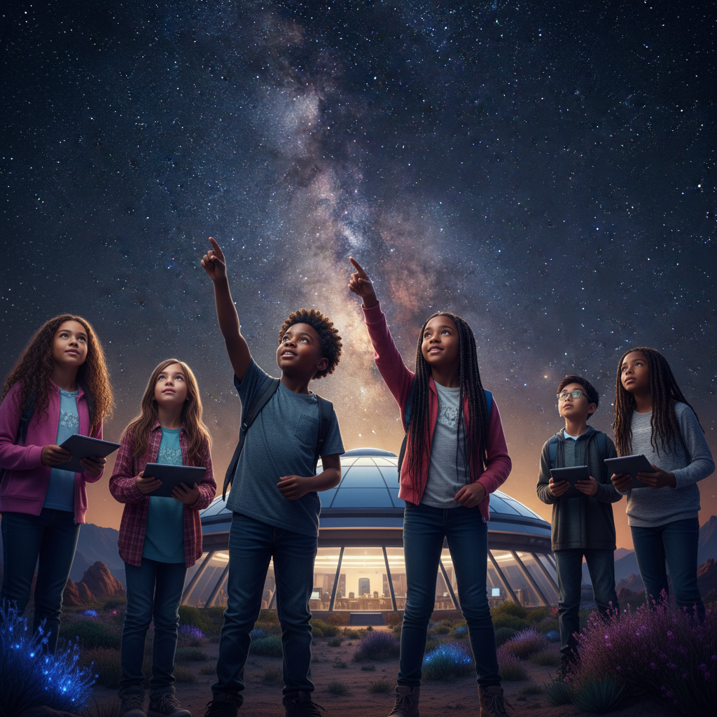
The Big Question
How do a star's distance and luminosity determine how bright it appears from Earth?
When You Look at a Star, You're Seeing the Past. Today we'll build a MODEL to discover the answer!
3/9

Slide 4

Today We Will Build a Model!
A model helps us understand complex systems!
1. LOCATE
Identify the COMPONENTS (parts) of the system
2. ESTABLISH
Connect them with RELATIONSHIPS (+ or -)
3. VISUALIZE
Build your model in ModelIt!
4. EVALUATE
Run SIMULATIONS to test scenarios
5. REVISE
Improve your model based on evidence
4/9

Slide 5
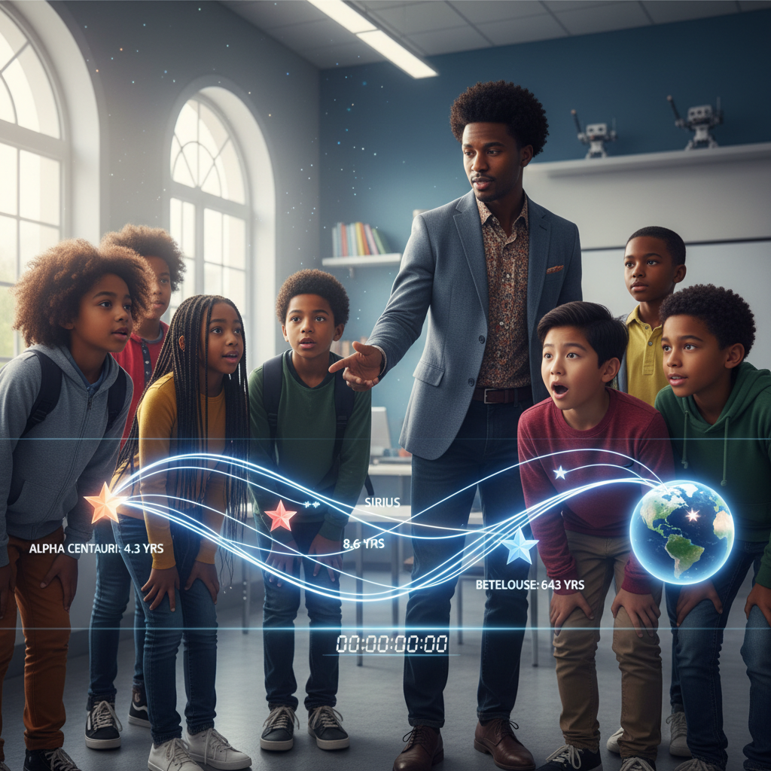
Activity 1: Sort the Components
Sort these components into EXTERNAL (inputs from outside) and INTERNAL (inside the system):
Your Components:
* Star Distance
* Star Actual Luminosity
* Light Travel Time
* Apparent Brightness
Think: Which components can we control? Which happen on their own?
5/9

Slide 6
Activity 2: Connect with Arrows
Draw arrows to show HOW components affect each other:
(+) POSITIVE Relationship
When one goes UP, the other goes UP too
(-) NEGATIVE Relationship
When one goes UP, the other goes DOWN
Think About It:
If a star is very far away, why might we still be able to see it?
6/9

Slide 7
Activity 3: Run the Simulation!
Test these scenarios in ModelIt!
The Sun
Distance very low, Luminosity moderate
Nearby Dim Star
Distance low, Luminosity very low
Distant Supergiant
Distance very high, Luminosity very high
Watch the activity graphs change!
[ModelIt Platform Screenshot - Simulation Results Graph]
7/9

Slide 8
What Did We Discover?
Our Model Showed Us:
* The sun looks brightest because it's CLOSE, not because it's special
* Distance has a NEGATIVE effect on apparent brightness
* Very luminous stars can be visible from thousands of light years away
* Light travel time means we're always seeing the past
Answer: Apparent brightness depends on both distance (closer = brighter) and luminosity (more luminous = brighter). The sun looks brightest because it's the closest star by far!
8/9

Slide 9
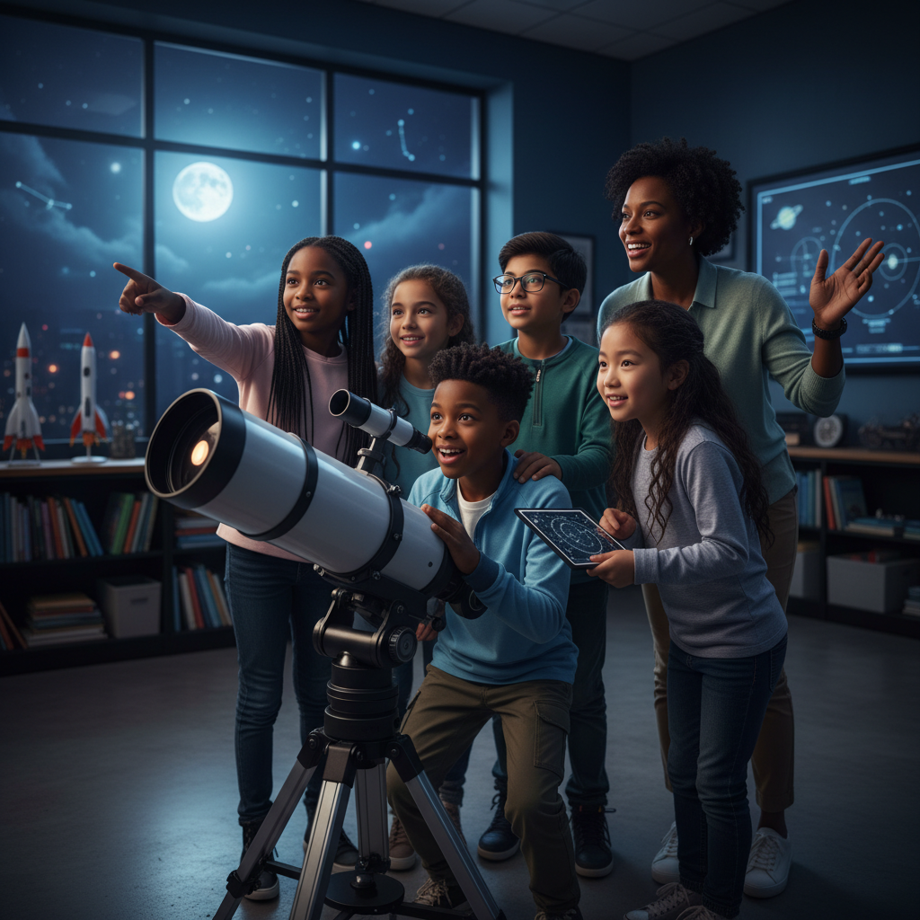
STEM Challenge: Design a Star Observation Mission
YOUR ENGINEERING MISSION
Design a mission to study a specific star using what you know about light travel time.
The Challenge:
NASA wants to study a star 100 light years away. What would observing it teach us? What are the challenges?
Think Like an Engineer:
* If we send a signal, how long until we get a response?
* What are we actually 'seeing' when we observe this star?
* How do we learn about stars we can never visit?
REAL CAREER CONNECTION: Astronomers and Astrophysicists study everything beyond Earth using the principles you modeled today. They earn $90,000-$145,000/year. The skills you're using TODAY are the same ones they use on the job!
9/9

